Slide 1

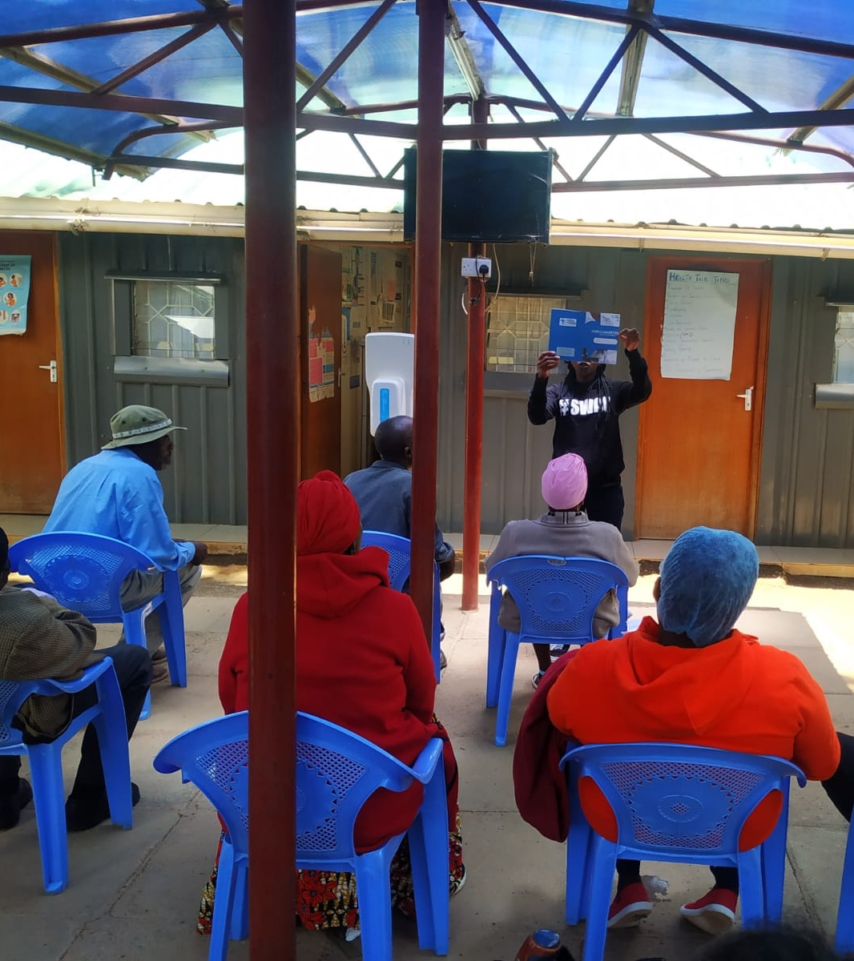
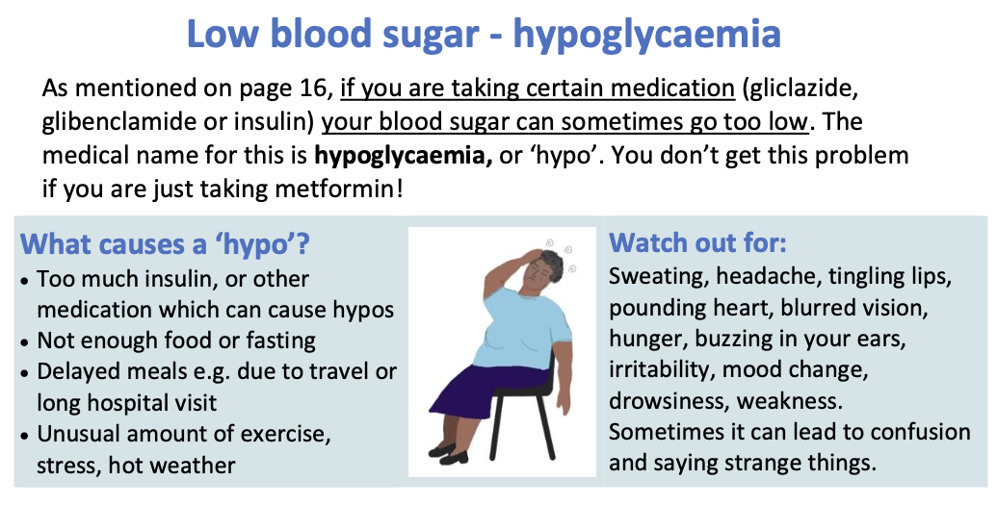
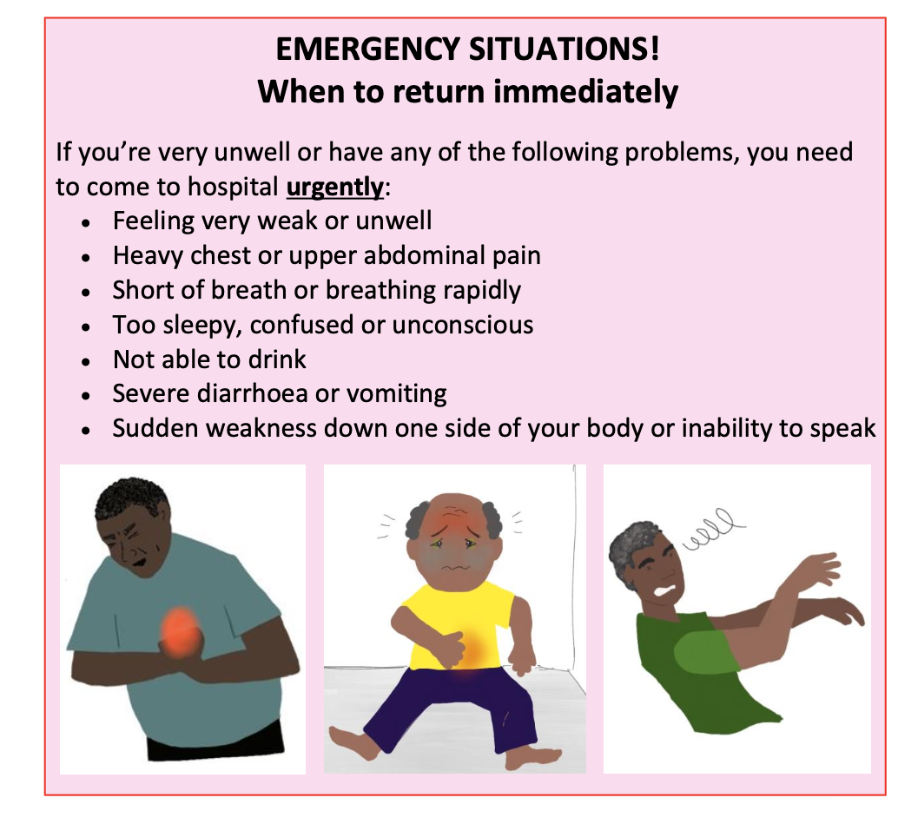
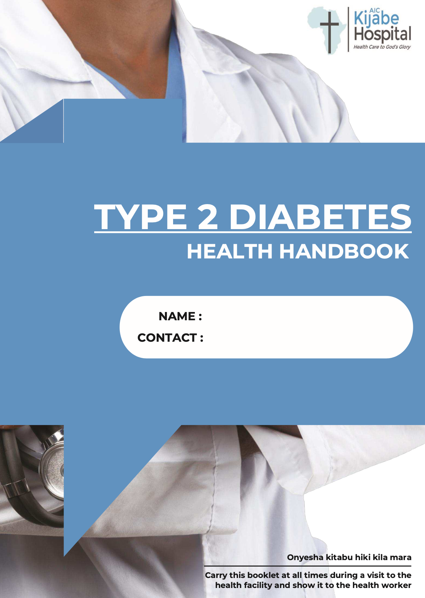

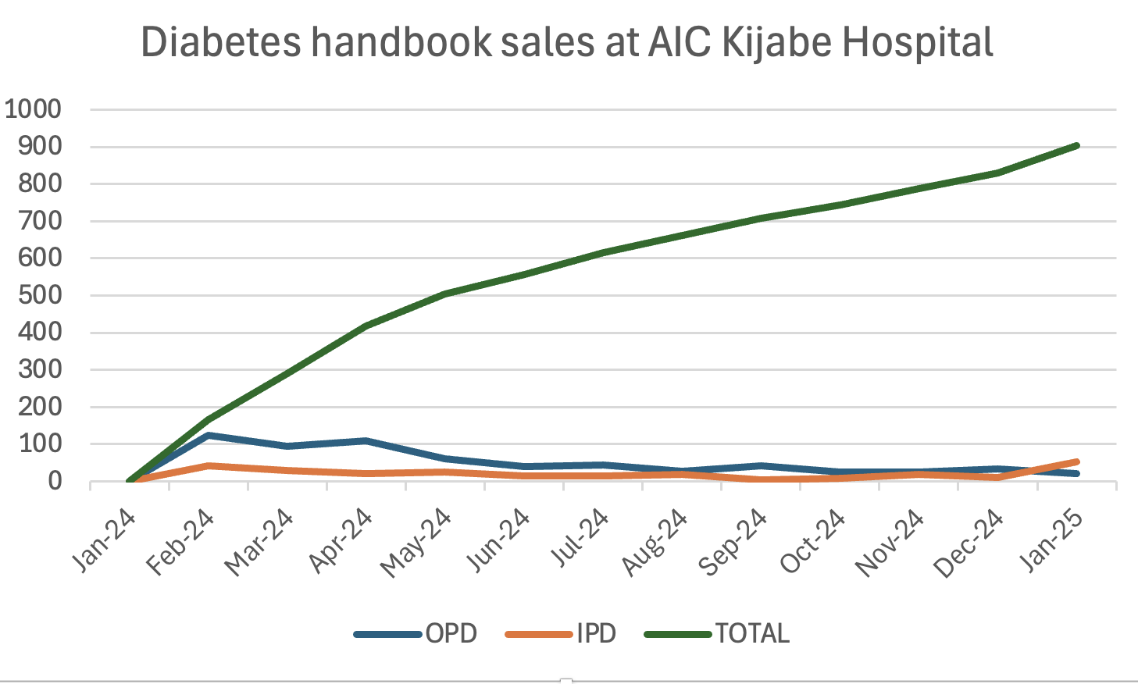
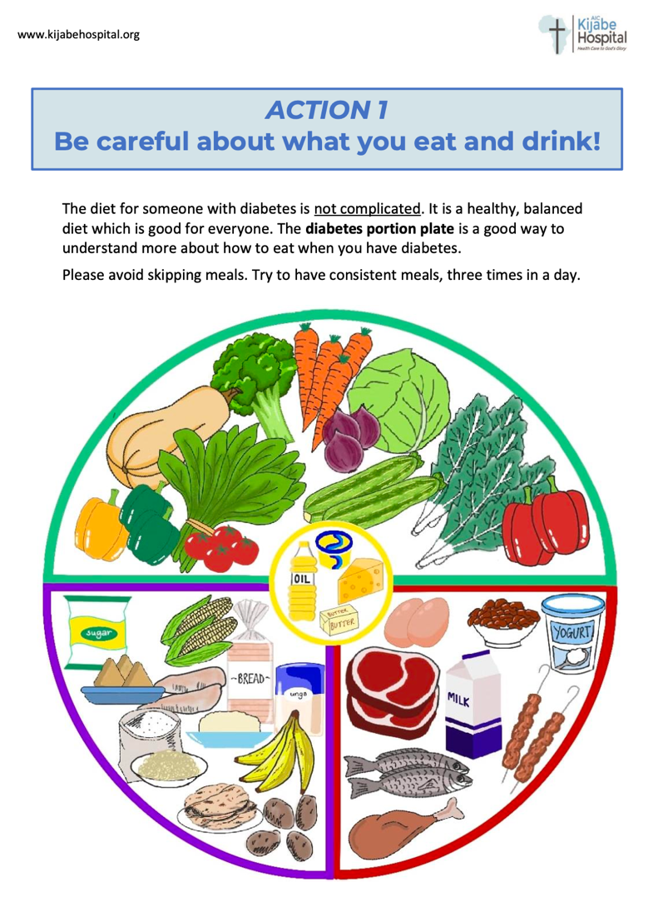
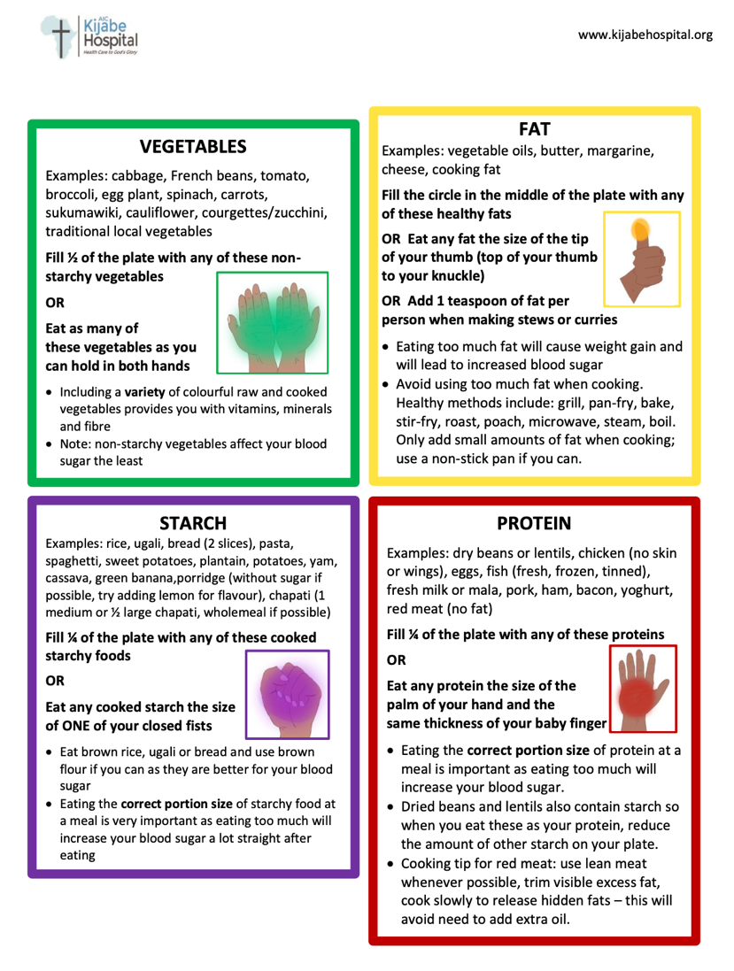
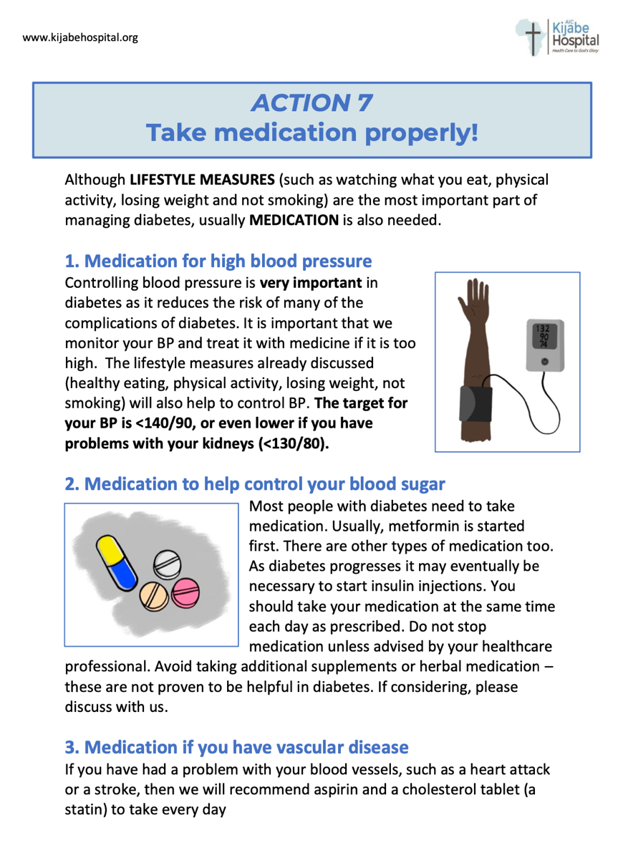
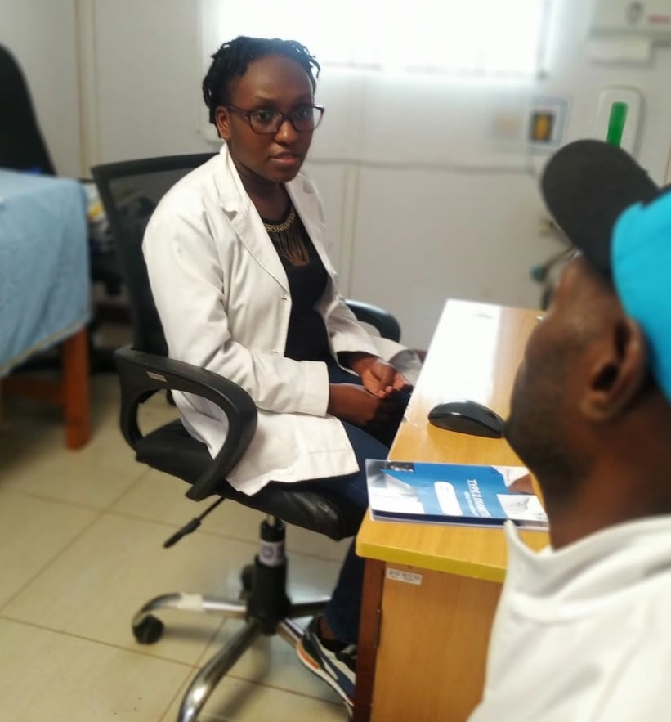
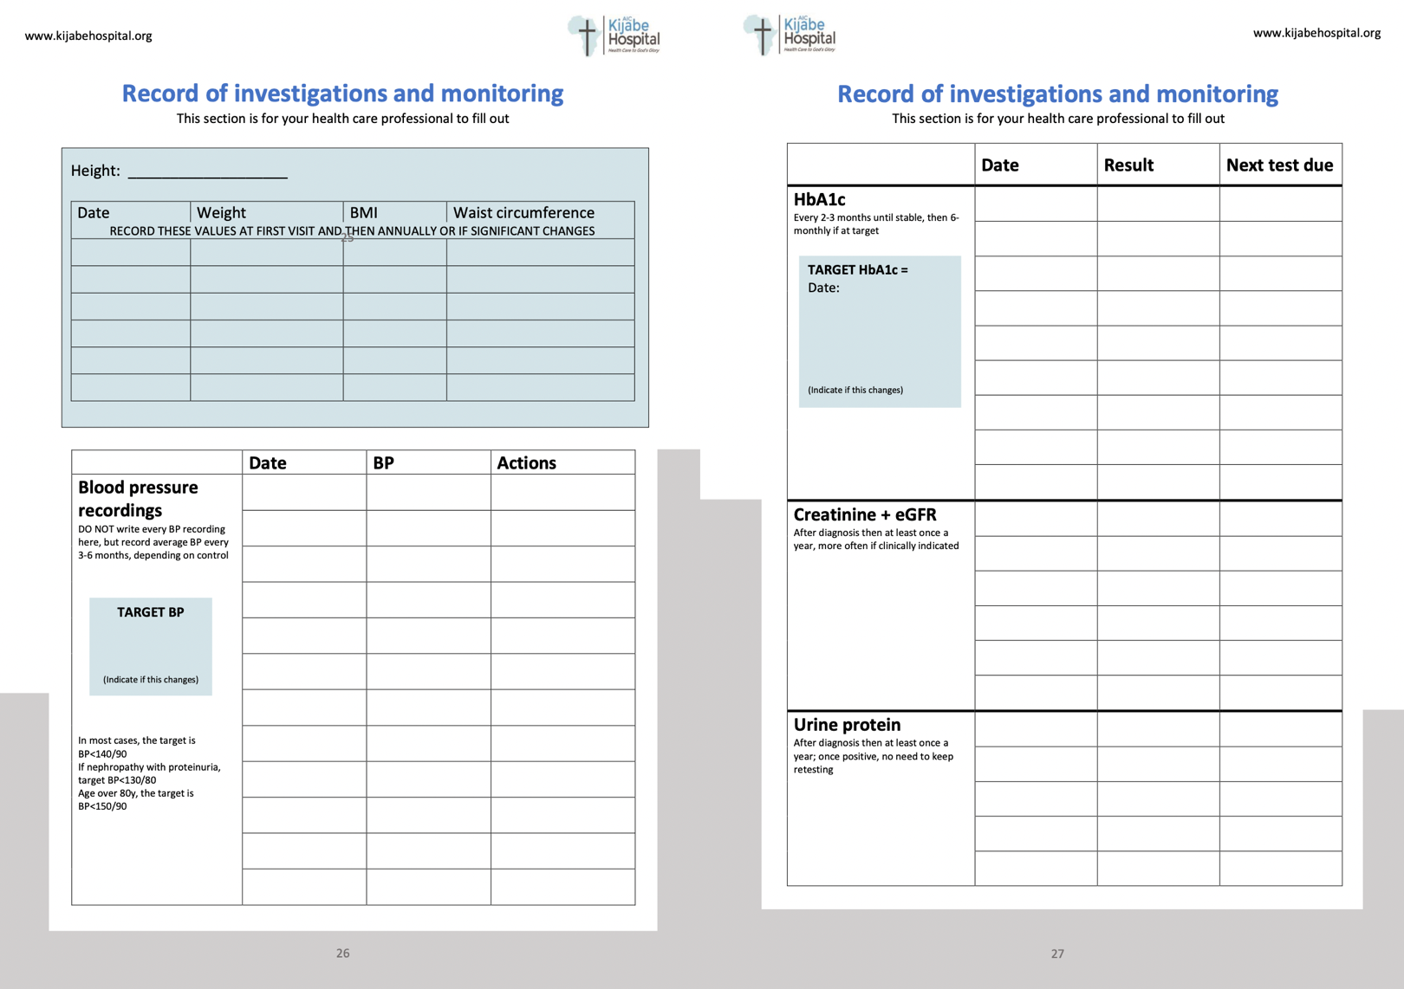
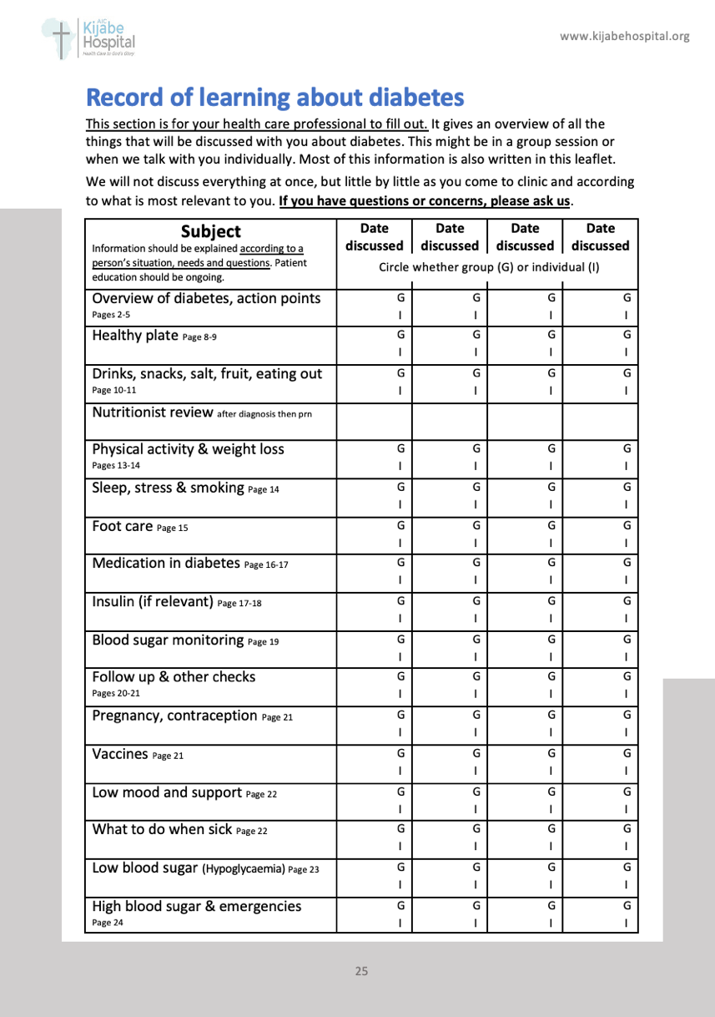
Improving diabetes care with a patient-held handbook
Katy Linley, Felix Magego, Beth Wanjiku, Irene Muthoni, Alice Wangu, Sarah Kamau, Stella Wangui, Stella K. Musundi, Nancy Njoroge, Moses Odhiambo
We wrote and illustrated a diabetes patient handbook which we launched in March 2024 at a cost of 125Kes. We are aiming that all patients with diabetes have this handbook and bring it to every appointment, much like the well-accepted and widely used national ANC booklet.
The emphasis of the handbook is to encourage patient ownership of their disease through ten action points.
The information in the booklet provides a standard for both individual and group education sessions to avoid confusing and conflicting messages. Patient educational events can be recorded to improve comprehensiveness and there is space for basic clinical information aimed at increasing continuity of care.
Background
Methods
The handbook has been copyrighted to AIC Kijabe Hospital and a second edition is being printed. We are now producing the handbook for other institutions in Kenya.
We have monitored the sales of the handbook, the number of patients returning to clinic with the handbook and if the handbooks have been filled out by clinicians. Finally, we are monitoring the percentage of patients who achieve target BP and HbA1c in CCC.
There is a high level of uptake of the handbook, with nearly 1000 handbooks sold at AIC Kijabe Hospital, and more sold at satellite clinics.
A recent spot survey of 10 patients in the waiting area showed all had the handbook, were very satisfied with it and were finding it helpful. Data collected by clinicians when seeing patients showed that 84% (32/38) had received the book and all had received individualised education. 31% (10/32) patients had brought their handbook back to clinic with them.
Diabetes prevalence is increasing dramatically worldwide with 10.5% of the global population aged 20-79y estimated to have diabetes.¹ Africa is projected to have the largest increase in cases over the next 20 years where already 3 in 4 deaths due to diabetes occur in people under the age of 60. In 2019, diabetes accounted for 10% of global health funding.²
Diabetes self-management education and support (DSMES) is a key aspect of diabetes care according to international recognized standards and national guidelines.^{3,4} DSMES has been shown to improve HbA1c levels, complication rates and quality of life.⁵ It also reduces hospitalisation and cost of healthcare.
Patients with diabetes at AIC Kijabe Hospital are primarily seen for follow-up care in the Chronic Care Clinic (CCC). A baseline survey among patients with diabetes who attended CCC in March 2024 showed 40% remembered receiving diabetes education at their last visit.
With a goal of improving the quality of care among diabetes patients, we wanted to improve DSMES in our clinic by the introduction of a patient-held handbook.
More educational events
are now taking place in
AIC Kijabe Hospital CCC
and healthcare staff
report feeling more
equipped to give diabetes
education.
This handbook is an effective and affordable tool to increase DSMES, with high satisfaction rates among staff and patients. We now need to
increase awareness among
patients and staff so that
patients always bring the
handbook with them to clinic
and its use increases.
Limitations of the study
include the small number of patients surveyed. Also, we do not yet have enough data to see improvements to HbA1c control or complication rates which is expected with DSMES.⁵
This handbook could easily be scaled up across the country, in much the same way as ANC booklets, to improve DSMES and ultimately diabetes care. As pioneers of this approach in Kenya, AIC Kijabe Hospital should lead this initiative.
IDF Diabetes Atlas (2021)
The Lancet Diabetes & Endocrinology, Volume 9, Issue 12, 799
Diabetes Care 2022 Nov 1;45(11):2753-2786
National clinical guidelines on the management of diabetes, MOH, 2024
Clin Diabetes. 2016 Apr;34(2):70–80
Interpretation
Findings
“More than 90% of diabetes care is self-care” IDF
References

